Slide 1
Software Version Control
Github and Git

Slide 2
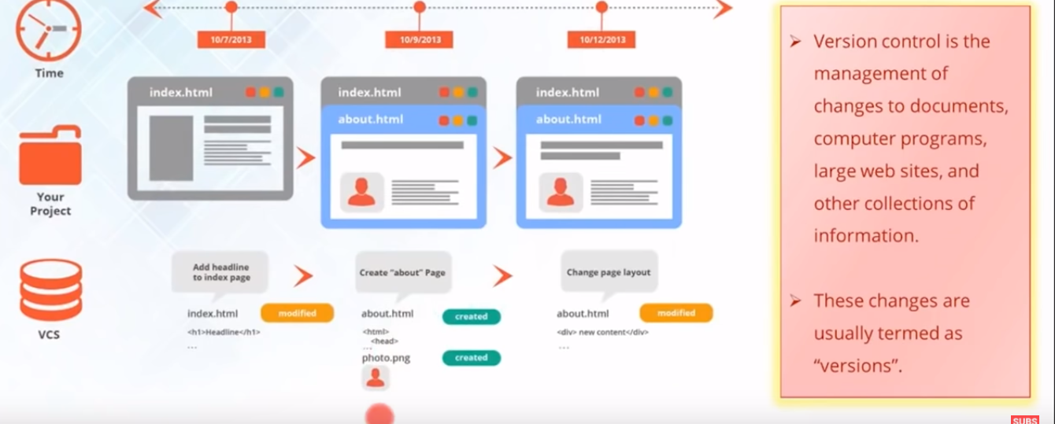
What is Version Control ?

Slide 3
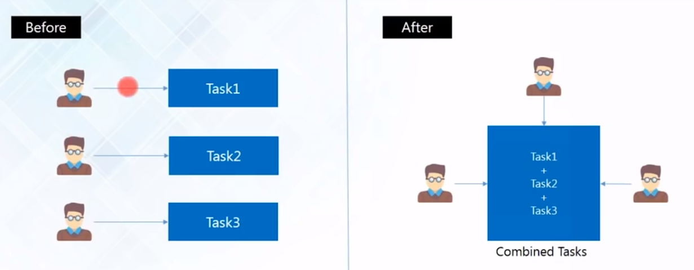
Need of Version Control – Collaboration

Slide 4
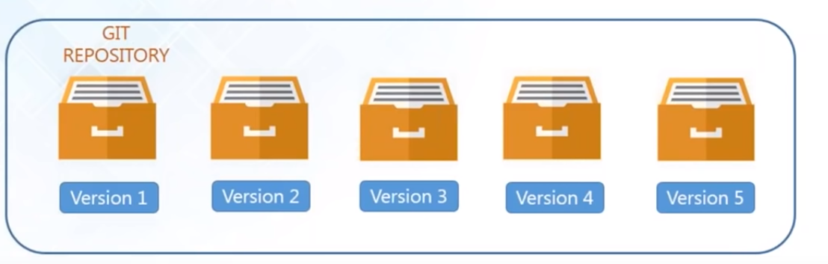
Need of Version Control – Store Versions

Slide 5
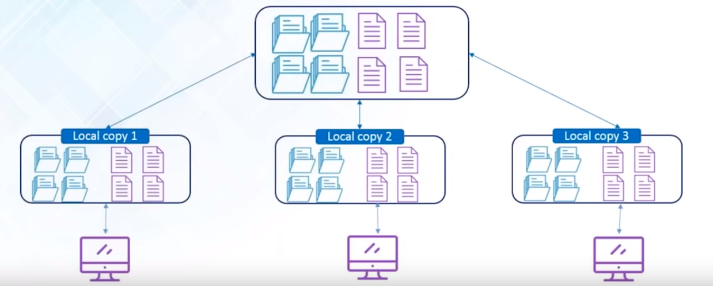
Need of Version Control – Backup

Slide 6
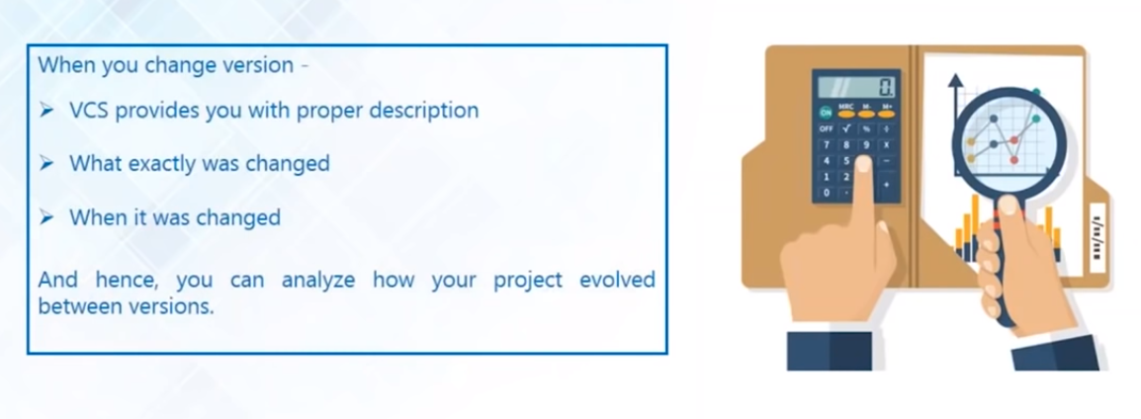
Need of Version Control – Analyze Project

Slide 7

Version Control Tools

Slide 8
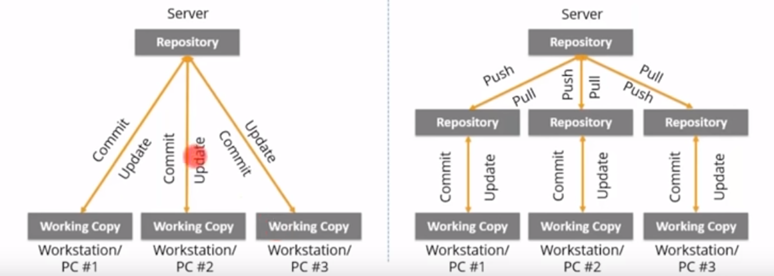
Centralized vs Distributed Version control

Slide 9
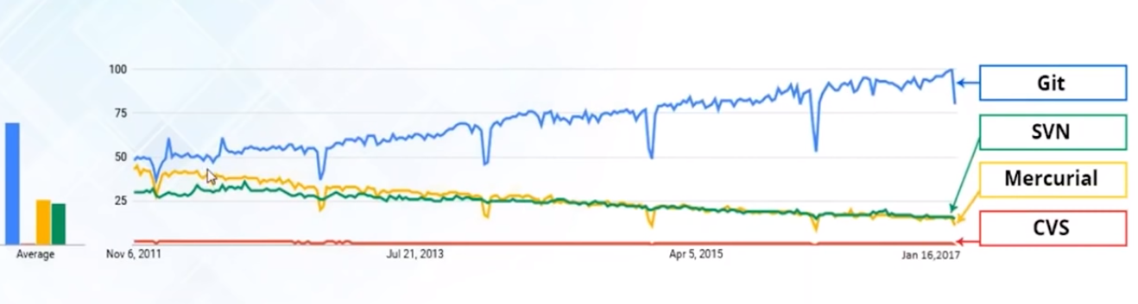
Why Git ?

Slide 10
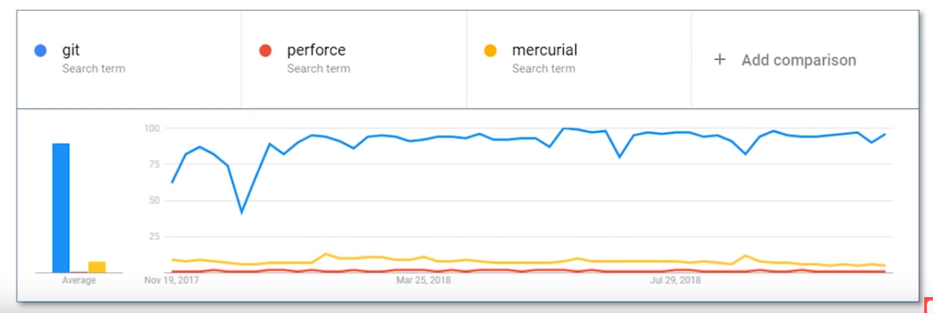
Why Git ?

Slide 11
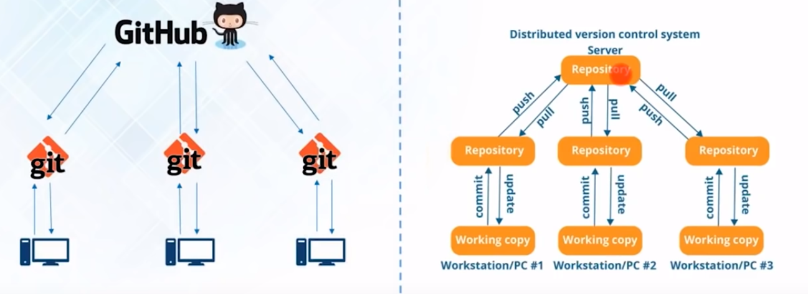
GitHub and git

Slide 12
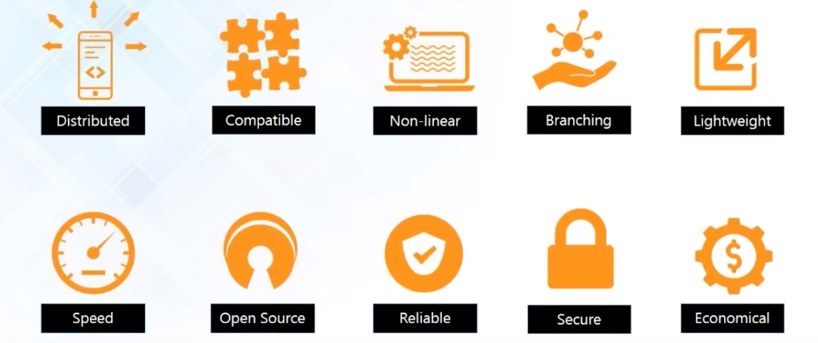
Git Features

Slide 13
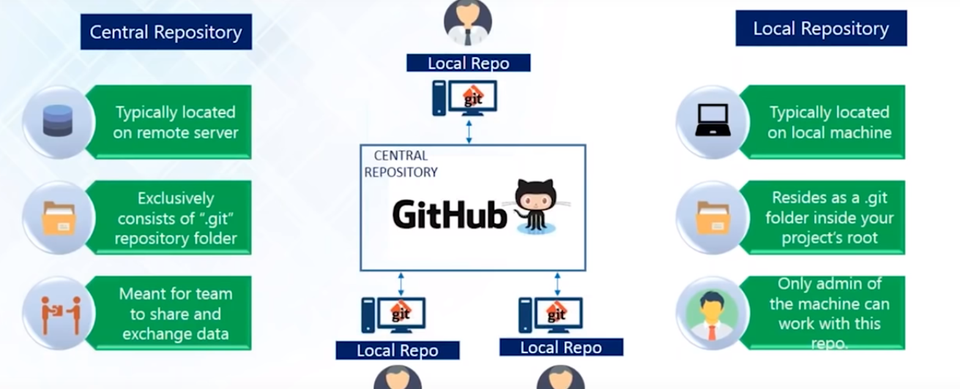
Repository

Slide 14
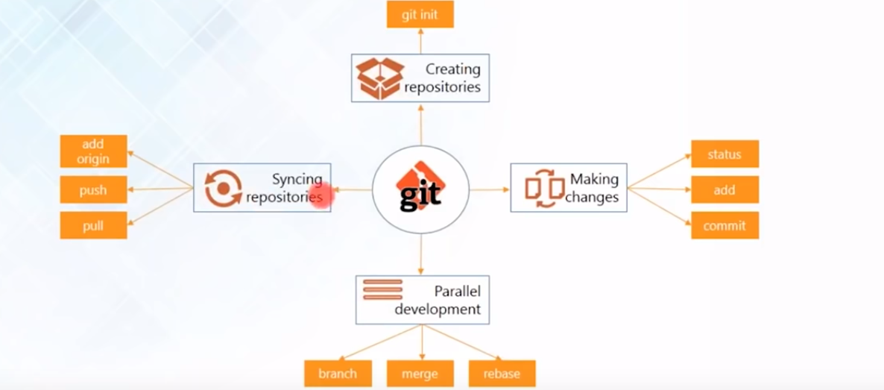
Git operations and Command

Slide 15
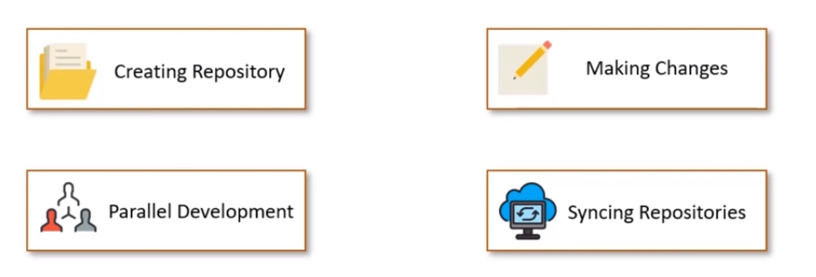
Git operations and Command

Slide 16
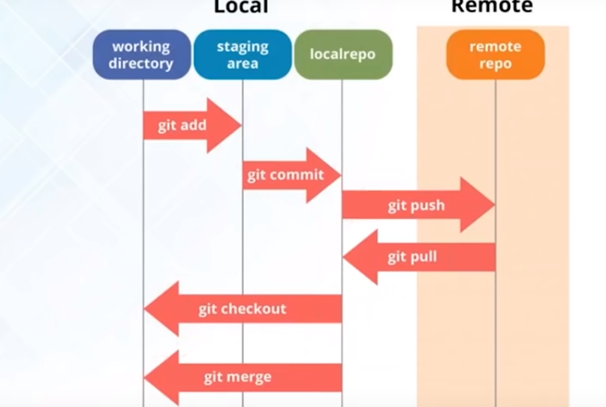
Git operations

Slide 17
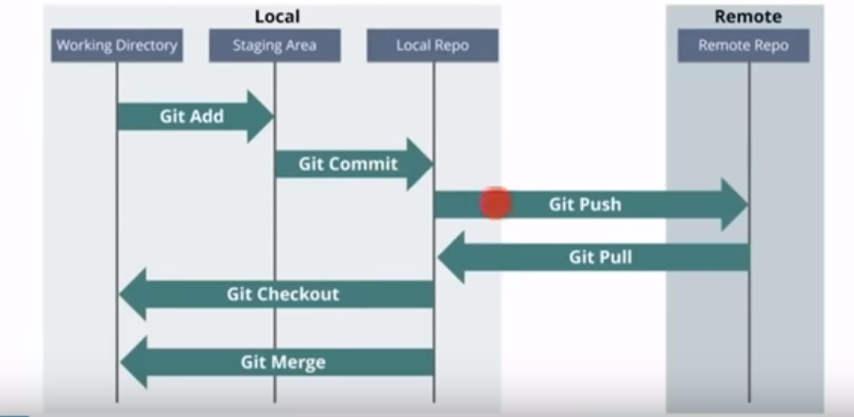
Git operations

Slide 18
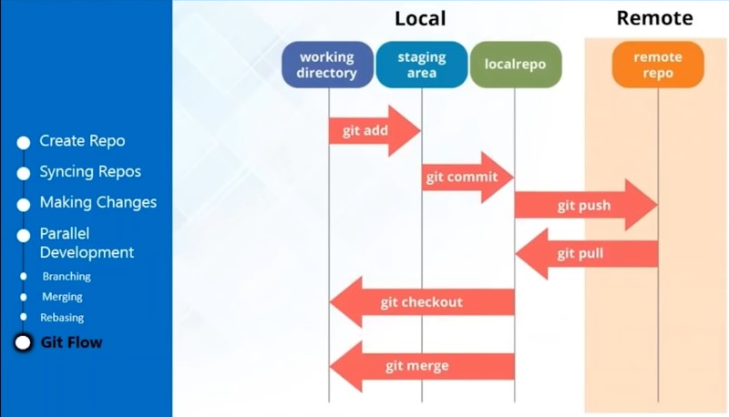
Git Flow

Slide 19
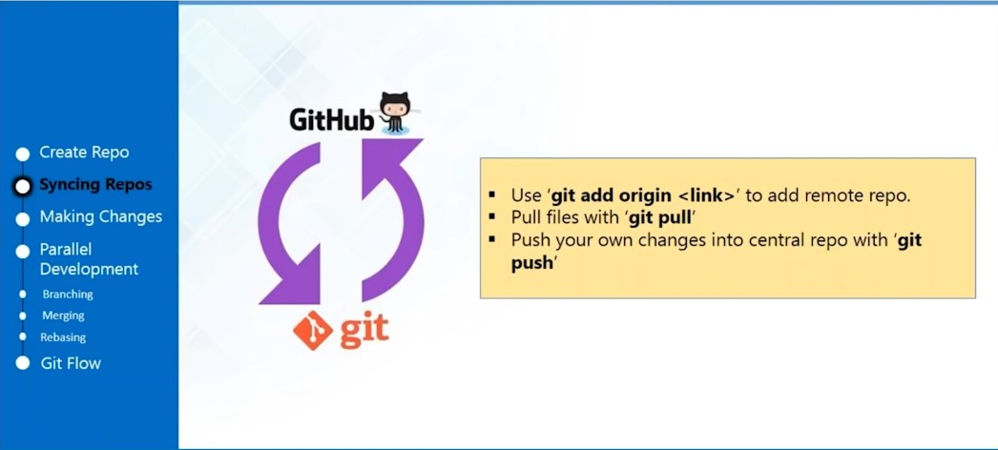
Git Syncing Repository

Slide 20
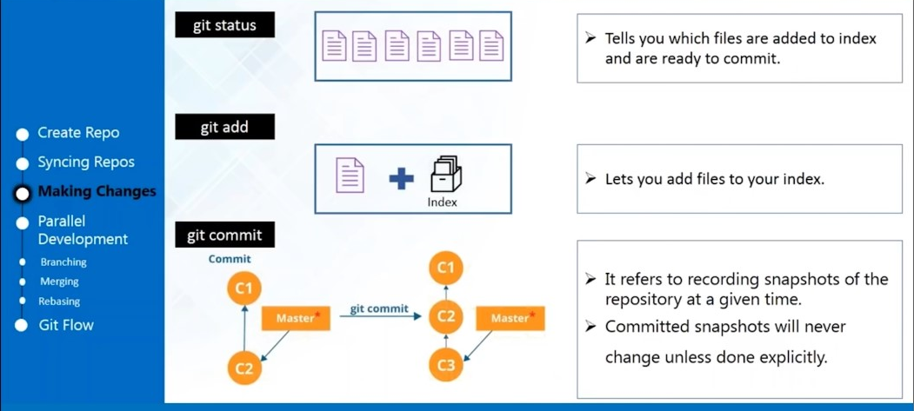
Making Changes

Slide 21
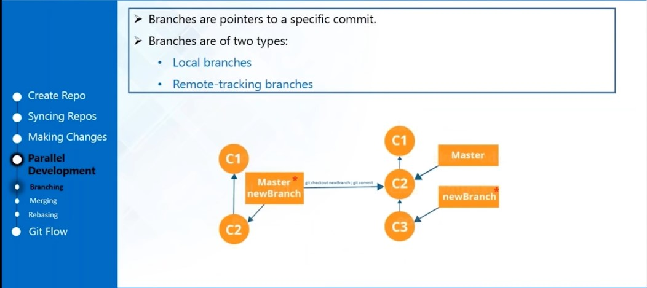
Parallel Development -Branching

Slide 22
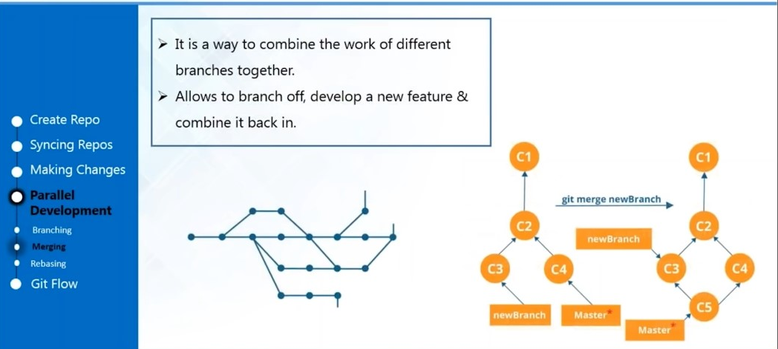
Parallel Development - Merging

Slide 23
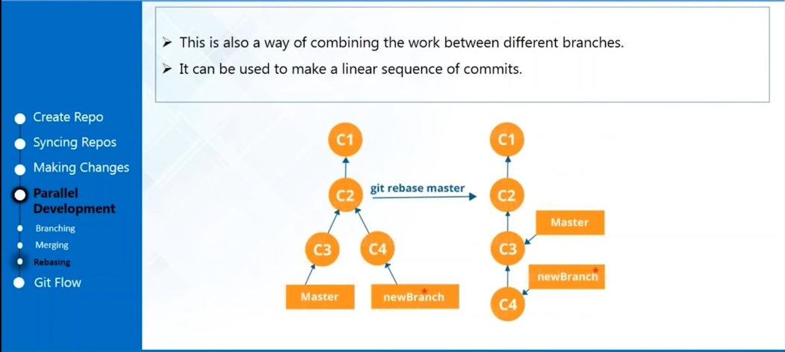
Parallel Development - Rebasing

Slide 24
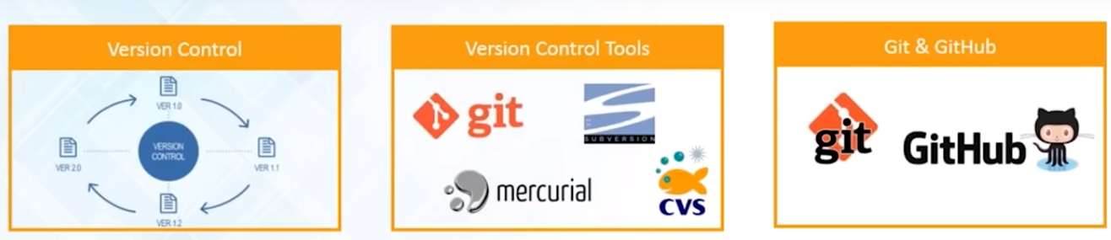
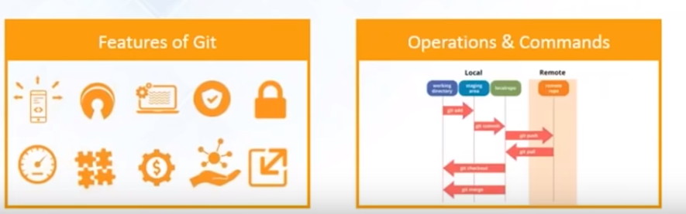
Git Summary

